Slide 1


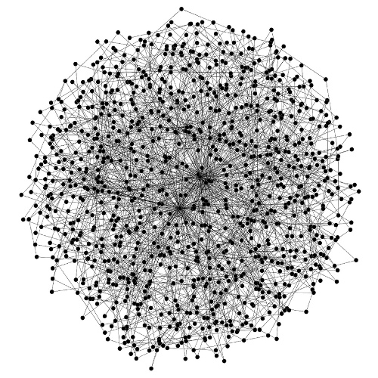

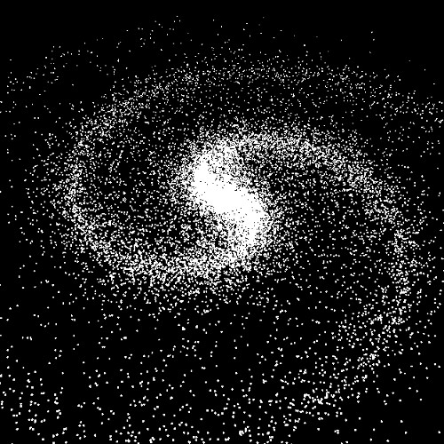
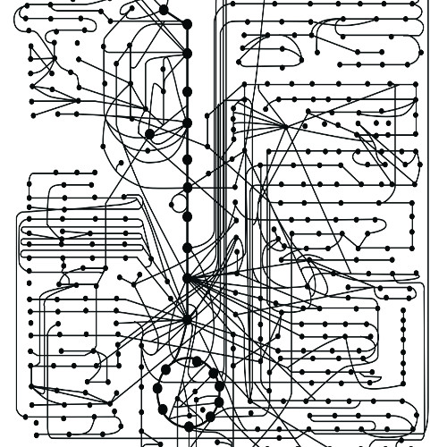
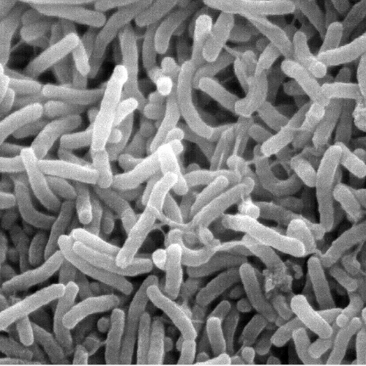
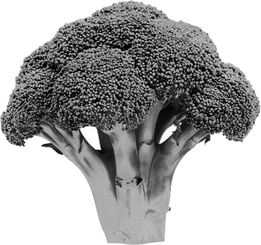

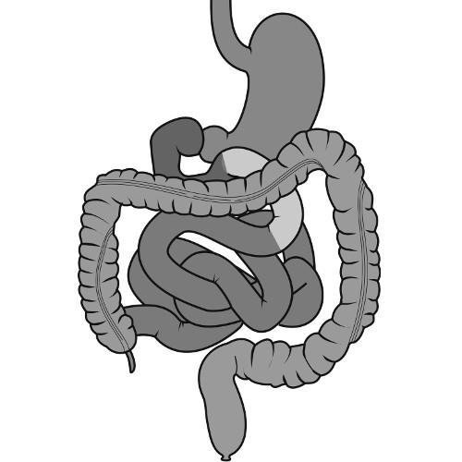

Application of biological priors to improve integration of multi-omics data sets
Wiktor Jurkowski

Slide 2
Statistical approaches for the analysis of High-dimensional data
Part I

Slide 3
Statistical Methods:
Exploring high-dimensional Data
Unsupervised Methods
Principal Component Analysis, PCA
Hierarchical Clustering
Supervised Methods
Regularised Linear Regression
Ridge
Lasso
Elastic Net
+
+
Molecular Interaction Network
Sparsity
Machine Learning
Random Forrest
Support Vector Machine
Neural Networks
…

Slide 4
Principal Component Analysis
Powerful tool to visualise high-dimensional data
Shows quantified difference among observations
Used to asses data quality and discover relationship between data points

Slide 5
Principal Component Analysis
Alternative coordinate systems
y
PCA uses covariance to encode the structure in the data and then eigenvectors to transform the data to a new set of coordinates that best reveals the structure of the data.
PCA computes an orthogonal matrix that performs a rotated-axis coordinate transformation such that we can transform our data matrix, D, to the new coordinates, D_{PCA}:
x
A data point in coordinates (x,y)
y'
y
x'
x
The data point in the new rotated-axis coordinates (x’,y’)

Slide 6
Hierarchical Clustering
Hierarchical clustering is another way to visualise high dimensional data. It clusters observations by distance and builds a hierarchical structure. It gives more detailed information of the differences among clusters, for example, what genes contributes the most to the differences between two clusters.
genes
control5
control2
case1
case3
case5
case4
case6
case2
case7
control3
control6
control7
control1
control4
samples

Slide 7
Statistical Learning with Sparsity
A sparse statistical model is one on which only a relatively small number of parameters (or predictors) play an important role.
For example, we hope that not all of the 30,000 or so genes in the human body are directly involved in the process that leads to the development of cancer.
Methods that study sparsity to help recover the underlying signal of the data.
Methods
Linear regression
Generalised Linear Regression
Generalisation of the Lasso Penalty
Statistical Inference
Sparse Multivariate Methods
Graph and Model Selection

Slide 8
Linear Regression
In which we observe N observations of an outcome variable Y and p associated predictor variables (or features) X = (x₁, …, x_{p})^{T}. The goal is to predict the outcome from the predictors, both for actual prefiction with future data and also to discover which predictors play an important role.
where β_{j} represents the parameters to be estimated

Slide 9
Linear Regression Algorithms
Least squares
Suitable when the response variable is quantitative and ideally when the error distribution is Gaussian.
Lasso
Prediction accuracy over least squares for two reasons:
1. Least squares estimate often has low bias but large variance, and prediction accuracy can someties be improved by shrinking the values of regression coefficients, or setting some coefficients to zero. By doing so we introduce some bias but reduce the variance of the predicted values and hence may improve the overall prediction accuracy (as measured in terms of the mean-squared error).
2. For purposes of interpretation: with a large number of predictors, we often would like to identify a smaller subset of these predictors that exhibit the strongest effects.
Generalised Linear Regression
Generalisations of simple linear models and the Lasso that are suitable of other applications, for example, binary variables when error follows a binomial distribution; counts as variables where the error follows a Poisson distribution.

Slide 10
Generalisation of Linear Models, GLM
Logistic Regression with regularisation
Good for cases where p > N (features is larger than samples)
Lasso-penalised logistic models
Coordinate descent
One versus one OR One versus all
Multinomial likelihood
Coordinate-descent
Grouped-Lasso penalty
Multiclass Logistic Regression with regularisation
Log Linear Models and the Poisson GLM
When the response variable is (nonnegative) counts, Poisson likelihood is often used for inference.
Survival time points data in medical studies when the outcome of interest after treatment is often time to death or time to recurrence of the disease.
Coordinate-descent (based-on)
Cox Proportional Hazards Models
Support Vector Machine, SVM
Binary classification.
Similar to penalised Logistic Regression
Notes:
Logistic Regression is very popular in biomedical research for half a century.
When over-parametrised, i.e., p > N (features is larger than samples), regularisation is needed to achieve a stable fit, i.e., traditional regression does not perform well with wide datasets with lots of correlation.

Slide 11
Feature Selection and Coefficient Shrinkage
Motivation:
Simplify our model: dimension reduction
There are three main reasons to perform feature selection:
Design consideration: reduce memory, improve speed
Interpretability: simple models are easier to interpert
Predictive Accuracy (overfitting): trade-off between:
How well ca we fit this particular dataset?
How well can the results be generalised to other datasets?
Cross Validation
It is a technique to determine whether a model can be generalised to other similar databases (it measure the accuracy of a model).
Approach:
Divide the dataset into training and test datasets
Fit the model to the training set
Use test set to evaluate goodness of fit
Theory
Signal is correlated across tests and training sets
Noise is uncorrelated across tests and training sets

Slide 12
Regularised Logistic Regression
Using a biological network as prior¹
GenePEN¹ identifies compact network activity alterations in functional omics datasets.
Aim:
To find a sparse set of discriminative genes that form a large connected subgraph of the input graph.
Regularised Logistic regression based on a convex optimisation problem:
Where f(w,v) is the expected logistic loss:
And penalty function is defined by¹:
¹ Vlassis, N., Glaab, E. (2015) GenePEN: analysis of network activity alterations in complex diseases via the pairwise elastic net. Stat. Appl. Genet. Mol. Biol. 2015; 14(2): 221-224.

Slide 13
Introduction to biological networks
Part II

Slide 14
Network types
Description and definition of networks depending on type of
Molecules: DNA, RNA, proteins, chemicals
Relations: molecular binding, chemical reactions, logical associations
Representation: graph, hypergraph

Slide 16
graph
hypergraph

Slide 17
Network processing and analysis
Network reconstruction
Network modularization
Network dynamics
Text mining
Expression data
Knowledge-based contextualization
Hubs detection
Signaling paths
Active
Differential
Conserved
Attractors
Steady states

Slide 18
Popular Tools to integrate data on networks
Part III

Slide 19
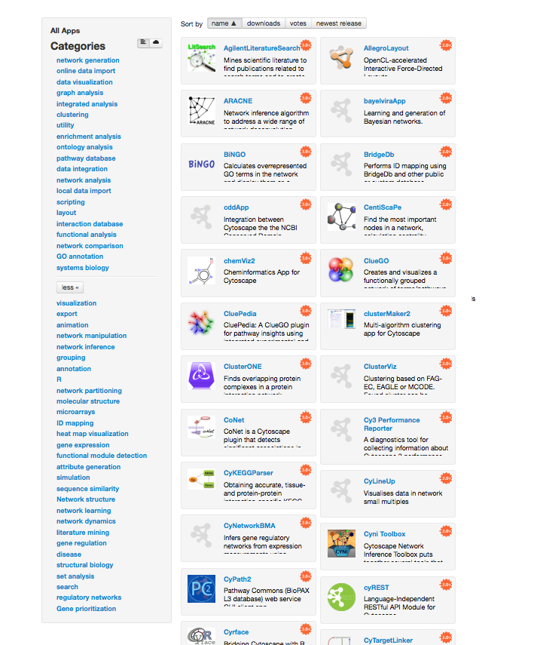
Cytoscape
Network construction, analysis and visualization environment
Dozens of plugins for network-related analysis
Network reconstruction: data driven, text mining, bayesian
Functional analysis: enrichment, GO, pathway analysis
Clustering and modularization
Graph analysis
Utility (formats, identifiers translation)

Slide 20
Others
Igraph (python, R)
Network analysis on Galaxy
Encore: Construction, analysis, and visualization of gene-gene interaction networks for sequencing data (Lareau CA et al.)
SBMLsqueezer: Generate kinetic rate equations for biochemical networks
PredPharmTox: Implements the QuantMap tools for grouping chemicals by biological activity (Schaal et al.)

Slide 21
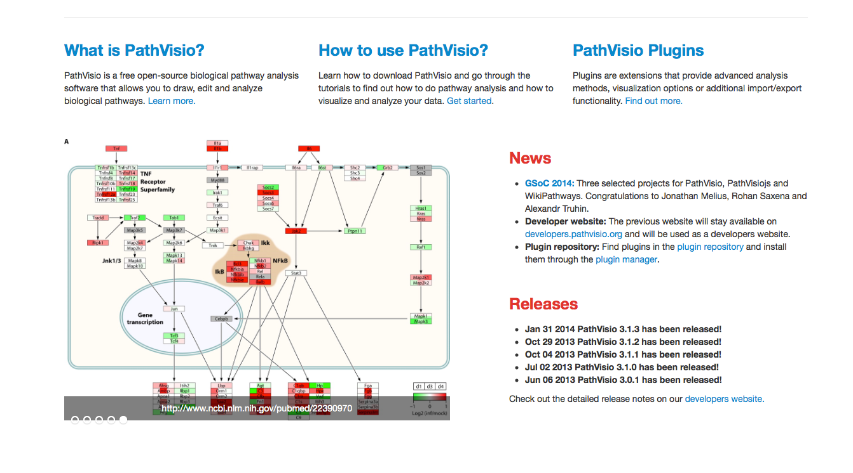
PathVisio
Free open-source pathway analysis and drawing software
Visualize your own experimental data
Find relevant pathways that are over-represented in your data set
Additional features available as plugins
Currently ~20 plugins available
Export/import, GO analysis

Slide 22
NETWORK ASSISTED BIOMARKER DISCOVERY
Part IV

Slide 23
Supervised classification procedure of using biomarker signatures for outcome prediction
( a )
A subset of features – biomarker signature is selected from the given experimental data e.g. samples of patients which are either healthy or diseased.
The measured values of the signature serve as an input to train a classifier.
( b )
The trained classifier model can predict the class labels of new observations
Disease status predicted from measurement of a patient with unknown health status
Struntz, 2016, Meth. Mol. Biol.

Slide 24
Limitations and Challenges of Biomarker Discovery
Problem: low reproducibility and the limited biological interpretability of candidate biomarker signatures identified from high-throughput data
Feature stability - similarity of ranked lists obtained either by applying the same feature selection method to slightly modified versions of the underlying data set (e.g. using different subsamples of the original data set) or by applying different feature selection methods on the same data set (Boulesteix A-L, Slawski M, 2009, Brief Bioinform)
High stability of features with respect to sampling variations is a good indicator for biomarker reproducibility
Markers which are tolerant against variations within data have a higher chance of having a high discriminatory power for experimental data from different studies generated in different laboratories

Slide 25
Limitations and Challenges of Biomarker Discovery
Sources of instability (He Z, Yu W, 2010, Comput Biol Chem)
multiple true markers, all allowing an equally accurate outcome prediction
small number of observations compared to the extremely high number of measured features in high-dimensional data can lead to instability
algorithms that are primarily designed to select feature subsets providing the best prediction accuracy and do not explicitly attach importance to the stability
By ignoring potential dependencies between the features, the selected signature may contain redundant information which impedes a synergistic improvement of the discriminatory power

Slide 26
Application of biological priors
Stability can be improved, through dimensionality reduction, by applying biological priors (Cun Y, Fröhlich H, 2012, Biology)
Network and data-centric approaches for application of biological priors
Network centric approaches for data integration: feature selection, incorporating prior information about pathways and molecular networks, and the supervised or unsupervised classification are uncoupled processes
Pathway Activity Analysis: inferring activity scores for specific pathways which are subsequently used for classification
Differential Network Analysis: identification of subnetworks or modules that serve as biomarker signatures
Network-assisted functional analysis

Slide 27
Pathway Activity Analysis
High throughput data
Canonical pathways
Use pathways instead of genes
Pathway activity score

Slide 28
Overview approaches for PAA
Tool | Method | Resource | Pathway activity measure | Classification method
- | Guo, 2005 | GO | Mean, median | Decision tree
- | Tomfohr (2005); Liu (2012) | KEGG, Biocarta; MsigDB | PCA (weighted sum of normalised expression) | -; probit regression; SVM
- | Lee, 2008; Yang, 2012 | MsigDB | Expression Z-score of condition-responsive genes | Logistic regression, SVM
- | Su, 2009 | MsigDB | Log-likelihood | Logistic regression
PARADIGM | Vaske, 2010 | PID | Factor graph models | Unsupervised clustering
-; | Kim, 2012; Tarca, 2009 | MsigDB, KEGG | GSEA | Hierarchical SVM
Pathway Studio + bsnea | Pyatnitskiy, 2014 | ResNet | SNEA | Unsupervised clustering

Slide 29
PAA limitations
Incomplete pathways
Neglecting topology. The method is accounting for expression of genes within pathway but ignoring connectivity
Solution:
Use networks instead of pathways
Definition of pathways is arbitrary

Slide 30
Differential Network Analysis
Different approaches to derive condition-specific networks
How the DNA can help in data analysis?
Okawa, 2015

Slide 31
Differential Network Analysis
Tool | Method | Resource | Network analysis | Biomarker selection
- | Chuang, 2007 | PPI | Greedy search of subnetwork | Permutation test (significant subnetworks)
- | Liu, 2012 | PPI: HPRD | Condition specific networks | Genes expressed in both conditions and in differential edges
- | Perumal, 2014 | GRN | Simulations of transitions between conditions | Genes in differentially expressed circuits
-; pathClass R package | Weng, 2011; Zhu 2009; Johannes, 2010 | PPI | Relation between expression values quantified by protein association | Difference of protein associations between networks; penalised SVM
DDN MATLAB toolbox | Zhang 2009; Tian 2014 | Any graph | Penalised linear regression for inference differential dependency network (a node given multiple parents) | Nodes in local significant subnetworks
GenPEN, MultiPEN | Vlassis, 2014; TroncosoRey (in prep.) | Any graph with weights | Penalised logistic regression | Genes ranked by model weights

Slide 32
Exploring limits of network ­driven omics integration
n
Build prediction models to explain phenotypes e.g. health vs. disease
Standard models e.g. logistic regression require p < n
p
p >> n problem
Associations between genes and metabolites
ONION
Clustering the genetic data according to its functionality and application of statistics to integrate the omics data
MultiPEN
Solve a penalised logistic regression to identify connectedness and coordinated changes in the biological network
Different, better than single data sets?
Network connectivity vs. quality?

Slide 33
ONION: BIOMARKER DISCOVERY in sub-netwroks
Part V

Slide 34
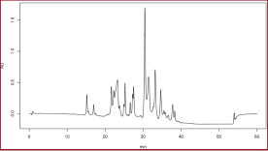
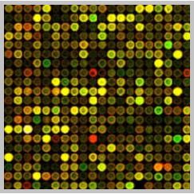
Integration of transcriptomics and metabolomics data
{
}
p>>n
Integrated pathways
+ Easy to implement enrichment analysis
Heterogeneity of pathway annotation
Bias towards biochemical reactions
Constrained Flux Balance
+ Precise calculation of mass balance
Depends on network consistency
Bias towards biochemical reactions
Bias towards well studied processes (with known kinetics)
Multivariate Statistics
+Associations between genes and metabolites
- Requires large data sets of multiple conditions (e.g. dietary regimes, age, sex etc.)

Slide 35
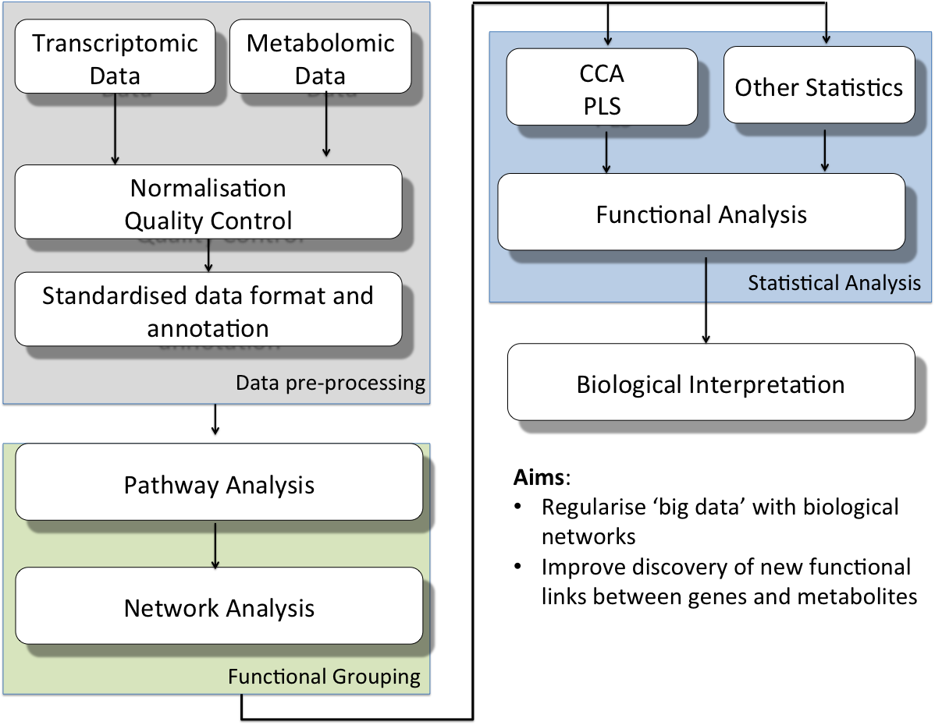



ONION: Network-guided multivariate analysis
ChEBI
Locally-low dimension
Piwowar M, Jurkowski W, PLoS One, 2015

Slide 36
Locally-low dimension
Small molecule clustering in ChEBI ontology and by fingerprints
Clusters centroids: subnetwork seeds
Genes/proteins in canonical pathways
Predicted and validated PPI Interactions
GROUPS
Current work
Bioconductor package
Improvement of MCS calculations
Gap filling in metabolic models
Notes:
Dassa

Slide 37

Comparison with randomized groups
4 groups vs. undivided data set
In both CCA and PLS results functional groups are significantly different than randomised groups one-sample t-test p<0.05
Notes:
Dassa

Slide 38
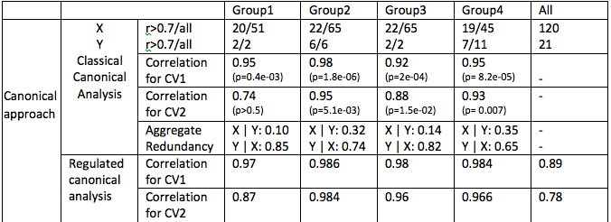
Groups vs. complete data
CCA of murine data. Canonical variables and p-values are calculated within functional groups (group 1-3), remaining variables (group 4) and for undivided data set. X – transcriptomics data; Y-lipidomics data; all – total number of variables; r0.7 – number variables after rejection of variables correlated on the 0.7 level
Notes:
Dassa

Slide 39
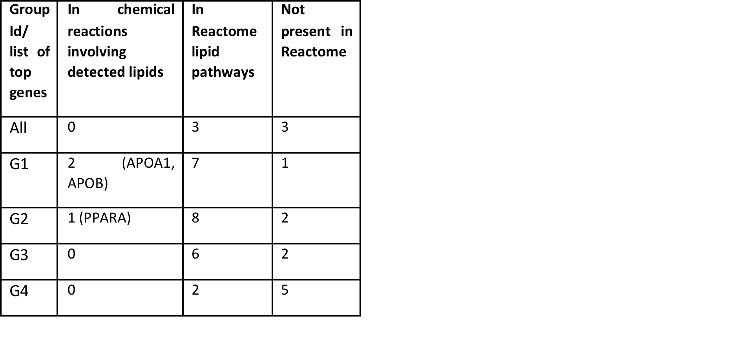
No significant pathways in not divided data set
Metabolism of lipids and lipoproteins
Defective CYP24A1 causes Hypercalcemia
GABA synthesis
Import of palmitoyl-CoA into the mitochondrial matrix
PPARA activates gene expression

Slide 40
Penalised logistic regression using networks
Part VI

Slide 41
Integrating omics datasets
An approach to integrate different type of data
Analyse (combined) data
transcriptomics
Proteins
Genes
metabolomics
Metabolites
Omics Data
Biological Priors
Prediction

Slide 42
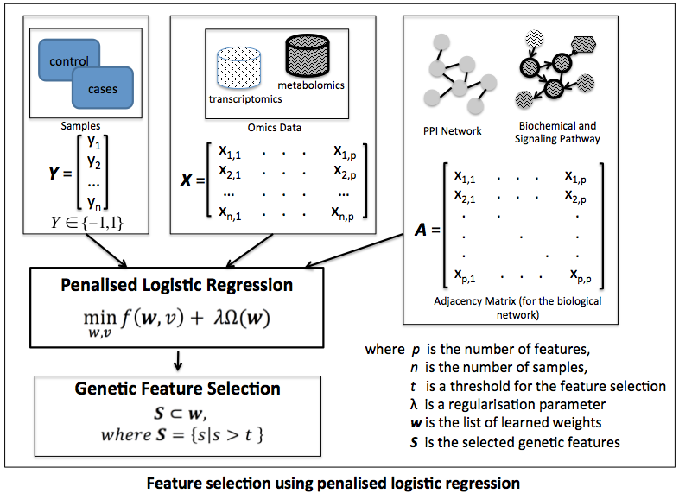
Penalised Logistic Regression using GenePEN¹
¹ Vlassis, N., Glaab, E. (2015) GenePEN: analysis of network activity alterations in complex diseases via the pairwise elastic net. Stat. Appl. Genet. Mol. Biol. 2015; 14(2): 221-224.

Slide 43
Penalised Logistic Regression using GenePEN¹
¹ Vlassis, N., Glaab, E. (2015) GenePEN: analysis of network activity alterations in complex diseases via the pairwise elastic net. Stat. Appl. Genet. Mol. Biol. 2015; 14(2): 221-224.

Slide 44
New section??
Part VII

Slide 45
The workflow
Pre-processing
Normalised Data
Mapping
-Human PPI Network-
Omics data
Filter genes
Extract connected components
Networks (PPI, GRN)
Sub-graphs
Subset of genes
GenePEN
MultiPEN
ONION
Feature Selection

Slide 46
Pathway, network assisted enrichment analysis
Tool | Method | Resource | Enrichment measure
DINA | Gambardella, 2013 | KEGG | Entropy-like measure for pathway activity
PSIA | Tarca, 2009 | MsigDB, KEGG | GSEA + signalling perturbation
Tool | Method | Resource | Network activity measure | Biomarker selection
 | Sun, 90 |  | Differential Interaction Networks
 | Islam, 91; Taylor, 92 |  | Differential modules | Prognosis signature based on differences between hubs in co-expression networks

Slide 48
References
Vlassis, N., Glaab, E. (2015) GenePEN: analysis of network activity alterations in complex diseases via the pairwise elastic net. Stat. Appl. Genet. Mol. Biol. 2015; 14(2): 221-224.
Statistical Learning with Sparsity: The Lasso and Generalisations, Trevor Hastie, Robert Tibshirani, Martin Wainwright, CRC Press, 2015
Integrating Omics Data, George Tseng, Debashis Ghosh, Xianghong Jasmine Zhou, Cambridge University Press, 2015

